Slide 1
Unit 2 ARRAYS
BY :
MRS. DEEPTI A. CHAUDHARI

Slide 2
NEED OF ARRAYS :
An array is a collection of similar data elements, it means it can hold group of integers, group of characters etc.
Suppose , we wish to read and store three integers, then one may define three variables of integer type.
eg. Int a, int b, int c;
Now if we wish to hold twenty integers , its difficult to define twenty variables and to remember which variable is holding what value , it is a big task for any programmer.
So in this case, we think of using arrays.

Slide 3
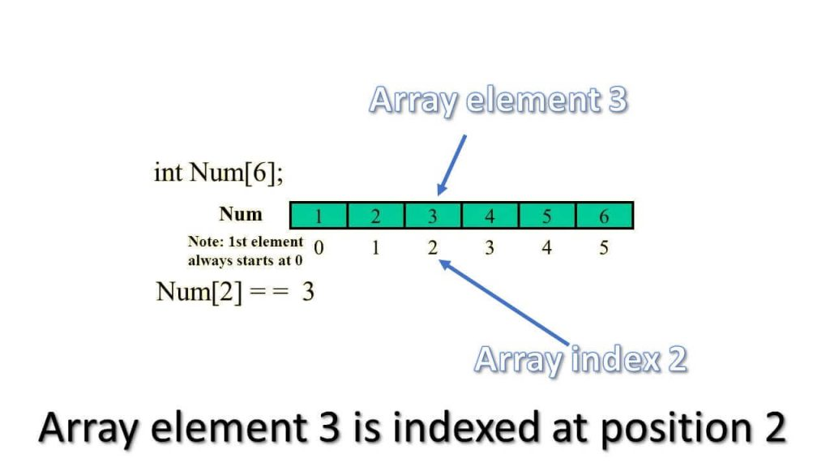
Declaration of an Array :
An array is declared as ,
datatype name [size];

Slide 4
Display integers using an array
#include<stdio.h>
Void main()
{
int i, a[10];
clrscr();
for(i=0; i<5; i++)
{
printf(“Enter value %d : “, i+1);
scanf(“%d”, &a[i]);
printf(“\n”);
}
for(i =0; i<5; i++)
{
printf(“ value %d =%d\n”, i+1, a[i]);
}
getch();
}
Output :
Enter value 1 : 5
Enter value 2 : 6
Enter value 3 : 3
Enter value 4 : 4
Enter value 5 : 2
Value 1 = 5
Value 2 = 6
Value 3 = 3
Value 4 = 4
Value 5 = 2

Slide 5
Initialisation of ARRAY
While using arrays we can accept values from user and we can also initialised array when we declared it.
int a[5] = { 4, 7, 2, 11, 13 };
If we want to print square of given numbers in array :
printf(“ Numbers \t Square \n”);
For(i=0; i<5;i++)
{
Printf(“%d \t “, a[i]);
printf(“%d \n”, a[i] *a[i]);
}

Slide 6
Sum of array values
int I, sum =0, num[10];
Printf(“ enter the 10 array values”);
For(i=0; i<10;i++)
{
scanf(“%d”,&num[i]);
sum = num[i] + sum;
}
Printf(“ Sum of values of array is : %d”, sum);

Slide 7
Find maximum number in array :
STEP 1: START
STEP 2: INITIALIZE arr[] = {25, 11, 7, 75, 56}
STEP 3: length= sizeof(arr)/sizeof(arr[0])
STEP 4: max = arr[0]
STEP 5: SET i=0. REPEAT STEP 6 and STEP 7 i<length
STEP 6: if(arr[i]>max) max=arr[i]
STEP 7: i=i+1.
STEP 8: PRINT "Largest element in given array:" assigning max.
STEP 9: RETURN 0
STEP 9: END.

Slide 8
Passing arrays to Function
Functions are the methods which are called from main ().
Functions has prototype as
return data type func_name(arg1, arg2,..);
Function has to be declared in main () before it call.
Declaration is like :
int add(int a, int b);
If not returning a value use void datatype.

Slide 9
Continued……
#include <stdio.h>
#include <conio.h>
void main()
{
int a[5]={10,5,45,12,19};
int n=5,m;
Int max(int a[],int n);
clrscr();
m=max(a,n);
printf("\n MAXIMUM NUMBER IS %d", m);
getch();
}
int max(int x[],int k)
{
int t, i;
t = x[0];
for(i=1; i<k; i++)
{
if(x[i]>t)
t=x[i];
}
return(t);
}

Slide 10
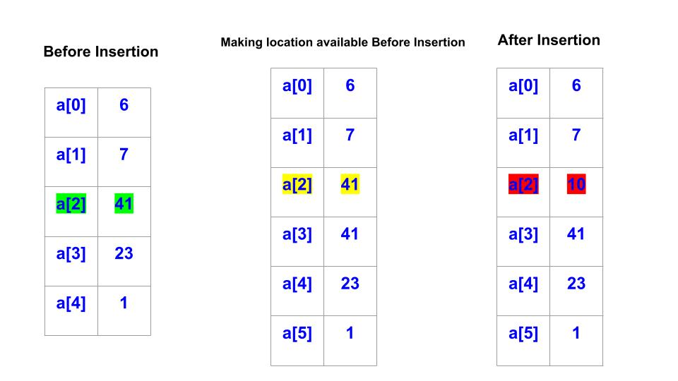
Inserting element in array
For inserting the element at required position, elements must be moved downwards to new locations.

Slide 11
Insert element in an Array
int main()
{
int student[40],pos,i,size,value;
printf("enter no of elements in array of students:");
scanf("%d",&size);
printf("enter %d elements are:\n",size);
for(i=0;i<size;i++)
scanf("%d",&student[i]);
printf("enter the position where you want to insert the element:");
scanf("%d",&pos);
printf("enter the value into that poition:");
scanf("%d",&value);
for(i=size-1;i>=pos-1;i--)
student[i+1]=student[i];
student[pos-1]= value;
printf("final array after inserting the value is\n");
for(i=0;i<=size;i++)
printf("%d\n",student[i]);
return 0;
}

Slide 12
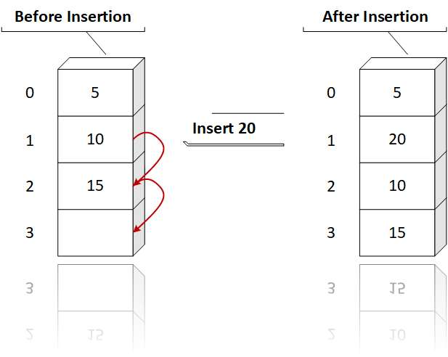
Algorithm to insert value in array :
(initialised the value of i] Set i= len
Repeat for i=len down to pos
( shift the elements down by 1 position)
set a[i+1] = a[i]
(End of loop)
Insert element at required position
set a[pos] =num;
(Reset len) Set len =len+1
Display the new list of arrays
End

Slide 13
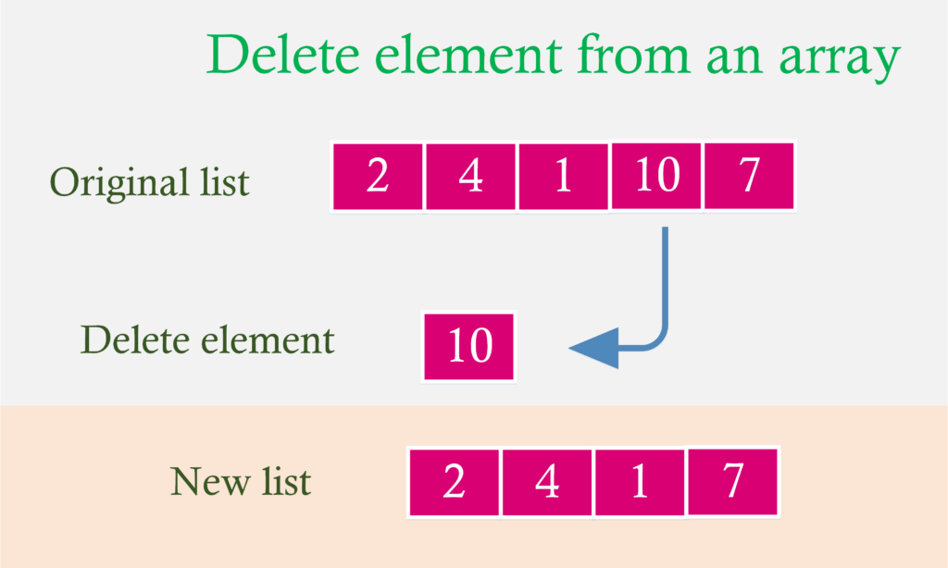
Deleting an Element from array
Algorithm
1. Set item = a[pos]
2. Repeat for j = pos to n-1
[ shifting elements 1 position upwards]
set a[j] = a[j+1] (end of loop)
3. Reset n= n-1
4. Display the new list of element of arrays
5. End

Slide 14
Delete element from array
int main()
{
int array[100], position, c, n;
printf("Enter number of elements in array\n");
scanf("%d", &n);
printf("Enter %d elements\n", n);
for (c = 0; c < n; c++)
scanf("%d", &array[c]);
printf("Enter the location where you wish to delete element\n");
scanf("%d", &position);
if (position >= n+1)
printf("Deletion not possible.\n");
else
{
for (c = position - 1; c < n - 1; c++)
array[c] = array[c+1];
printf("Resultant array:\n");
for (c = 0; c < n - 1; c++)
printf("%d\n", array[c]);
}
return 0;
}

Slide 15
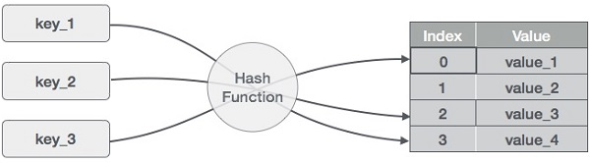
Hash Table
Hash Table is a data structure which stores data in an associative manner.
Hash Table uses an array as a storage medium and uses hash technique to generate an index where an element is to be inserted or is to be located from.
HASHING :
Hashing is a technique to convert a range of key values into a range of indexes of an array. We're going to use modulo operator to get a range of key values. Consider an example of hash table of size 20, and the following items are to be stored. Item are in the (key,value) format.
(1,20)
(2,70)
(42,80)
(4,25)
(12,44)
(14,32)
(17,11)
(13,78)
(37,98)
Here we can see the key for particular values

Slide 16
Indexing of Hash Table
Sr. no | key | Hash | Array index
1 | 1 | 1 % 20 = 1 | 1
2 | 2 | 2 % 20 = 2 | 2
3 | 42 | 42 % 20 = 2 | 2
4 | 4 | 4 % 20 = 4 | 4
5 | 12 | 12 % 20 = 12 | 12
6 | 14 | 14 % 20 = 14 | 14
7 | 17 | 17 % 20 = 17 | 17
8 | 13 | 13 % 20 = 13 | 13
9 | 37 | 37 % 20 = 17 | 17

Slide 17
Linear Probing
As we can see, it may happen that the hashing technique is used to create an already used index of the array. In such a case, we can search the next empty location in the array by looking into the next cell until we find an empty cell. This technique is called linear probing.
Sr.No. | Key | Hash | Array Index | After Linear Probing, Array Index
1 | 1 | 1 % 20 = 1 | 1 | 1
2 | 2 | 2 % 20 = 2 | 2 | 2
3 | 42 | 42 % 20 = 2 | 2 | 3
4 | 4 | 4 % 20 = 4 | 4 | 4
5 | 12 | 12 % 20 = 12 | 12 | 12
6 | 14 | 14 % 20 = 14 | 14 | 14
7 | 17 | 17 % 20 = 17 | 17 | 17
8 | 13 | 13 % 20 = 13 | 13 | 13
9 | 37 | 37 % 20 = 17 | 17 | 18

Slide 18
Multidimensional array indexing
A[3][3] b[3][3]
3 4 5 1 3 2
1 3 2 2 1 1
6 1 1 4 1 2
A[0][0]= 3
A[0][1]=4
A[0][2]= 5
A[1][0]= 1
A[1][1]= 3
A[1][2]= 2
A[2][0]= 6
A[2][1]= 1
A[2][2]= 1

Slide 19
Multi Dimensional Matrix
For(i =1; i < r; i++) r=3 1<3
{
for(j = 2; j < 3 ; j++) c=3 2<3
{
scanf(“%d\n”,&a[i][j]); a[0][0]= 2 2 1 3
} a[0][1]= 1 4 5 1
printf(“\n”); a[0][2] = 3
a[1][0]= 4 a[1][1] = 5
} a[1][2] = 1
for (c = 0; c < m; c++) {
for (d = 0 ; d < n; d++) {
sum[c][d] = first[c][d] + second[c][d];
printf("%d\t", sum[c][d]);
}
printf("\n");
}

Slide 20
Matrix muliplication
matrix a
1 2
2 4
3 5 2
Matrix b
3 1
2 1
5 4
A[0][1] =1
B[1][0] = 4 4
A[0][2] = 2
B[2][0] = 3
3*2+1*4+2*3
Mul[0][0]
16

Slide 21
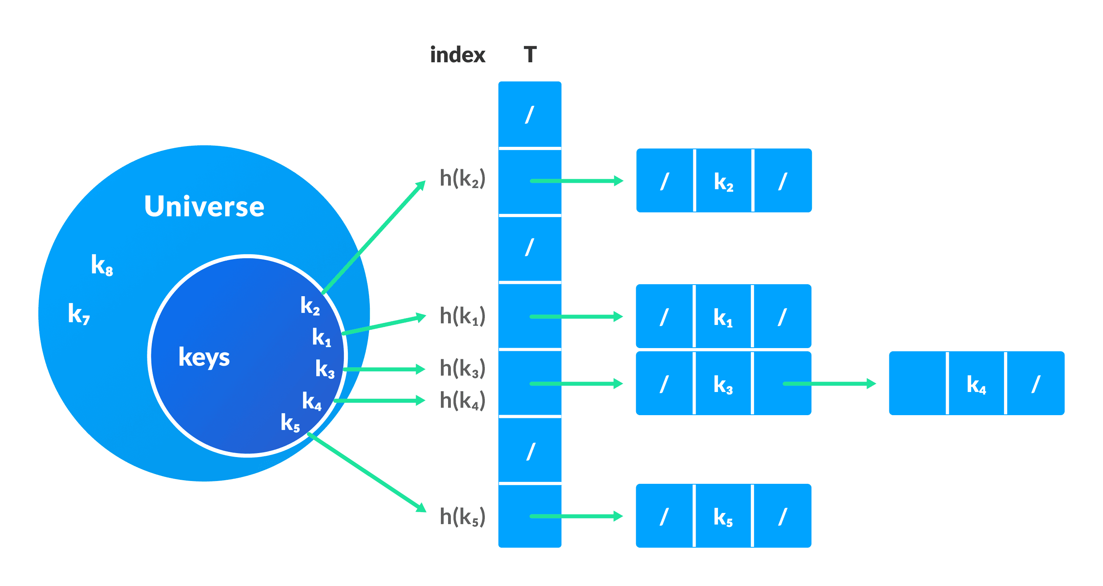
Hash Collision
When the hash function generates the same index for multiple keys, there will be a conflict (what value to be stored in that index). This is called a hash collision.
We can resolve the hash collision using one of the following techniques.
Collision resolution by chaining Open Addressing: Linear/Quadratic Probing and Double Hashing.
1. Collision resolution by chaining
In chaining, if a hash function produces the same index for multiple elements, these elements are stored in the same index by using a doubly-linked list.
If j is the slot for multiple elements, it contains a pointer to the head of the list of elements. If no element is present, j contains NIL.

Slide 22
Open Addressing
Unlike chaining, open addressing doesn't store multiple elements into the same slot. Here, each slot is either filled with a single key or left NIL.
Different techniques used in open addressing are:
Linear Probing
Refer slide no 17
2. Quadratic Probing
It works similar to linear probing but the spacing between the slots is increased (greater than one) by using the following relation.
h(k, i) = (h′(k) + c₁i + c₂i²) mod m
where,
c₁ and c₂ are positive auxiliary constants,
i = {0, 1, ….}
3. Double hashing
If a collision occurs after applying a hash function h(k), then another hash function is calculated for finding the next slot.
h(k, i) = (h₁(k) + ih₂(k)) mod m
Where m is the size of the table.

Slide 23
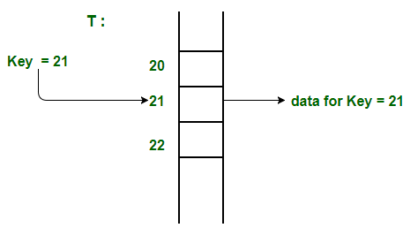
Direct addressing :
Direct Address Table is a data structure that has the capability of mapping records to their corresponding keys using arrays. In direct address tables, records are placed using their key values directly as indexes. They facilitate fast searching, insertion and deletion operations.
We can understand the concept using the following example. We create an array of size equal to maximum value plus one (assuming 0 based index) and then use values as indexes. For example, in the following diagram key 21 is used directly as index.

Slide 24
Continued…..
Advantages of Direct Addressing :
Searching in O(1) Time: Direct address tables use arrays which are random access data structure, so, the key values (which are also the index of the array) can be easily used to search the records in O(1) time.
Insertion in O(1) Time: We can easily insert an element in an array in O(1) time. The same thing follows in a direct address table also.
Deletion in O(1) Time: Deletion of an element takes O(1) time in an array. Similarly, to delete an element in a direct address table we need O(1) time.

Slide 25
Applications of Hash Table
Hash tables are implemented where
constant time lookup and insertion is required
cryptographic applications
indexing data is required

Slide 26
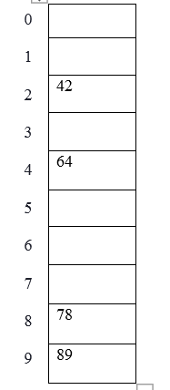
Types og Hash Functions
Division method
Hash (key) = Elements % table size;
2 = 42 % 10;
8 = 78 % 10;
9 = 89 % 10;
4 = 64 % 10;
2. Mid Square Method
In this method, the middle part of the squared element is taken as the index.
Element to be placed in the hash table are 210, 350, 99, 890 and the size of the table be 100.
210* 210 = 44100, index = 1 as the middle part of the result (44100) is 1.
350* 350 = 122500, index = 25 as the middle part of the result (122500) is 25.
99* 99 = 9801, index = 80 as the middle part of the result (9801) is 80.
890* 890 = 792100, index = 21 as the middle part of the result (792100) is 21.

Slide 27
3. Digit Folding Method
In this method the element to be placed in the table using hash key, which is obtained by dividing the elements into various parts and then combine the parts by performing some simple mathematical operations.
Element to be placed are 23576623, 34687734.
hash (key) = 235+766+23 = 1024
hash key) = 34+68+77+34 = 213

Slide 28
Sparse Matrix
Sparse matrices are those matrices that have the majority of their elements equal to zero. In other words, the sparse matrix can be defined as the matrix that has a greater number of zero elements than the non-zero elements.
Why do we need to use a sparse matrix instead of a simple matrix?
We can also use the simple matrix to store the elements in the memory; then why do we need to use the sparse matrix. The following are the advantages of using a sparse matrix:
Storage: As we know, a sparse matrix that contains lesser non-zero elements than zero so less memory can be used to store elements. It evaluates only the non-zero elements.
Computing time: In the case of searching n sparse matrix, we need to traverse only the non-zero elements rather than traversing all the sparse matrix elements. It saves computing time by logically designing a data structure traversing non-zero elements.
Representing a sparse matrix by a 2D array leads to the wastage of lots of memory. The zeroes in the matrix are of no use to store zeroes with non-zero elements. To avoid such wastage, we can store only non-zero elements. If we store only non-zero elements, it reduces the traversal time and the storage space.

Slide 29
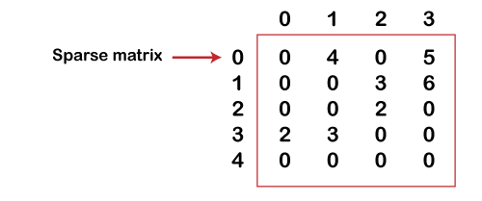
Continued……
Array Representation
Row: It is an index of a row where a non-zero element is located.
Column: It is an index of the column where a non-zero element is located.
Value: The value of the non-zero element is located at the index (row, column).
Let's understand the sparse matrix using array representation through an example.
Let's understand the sparse matrix using array representation through an example.
As we can observe above, that sparse matrix is represented using triplets, i.e., row, column, and value. In the above sparse matrix, there are 13 zero elements and 7 non-zero elements. This sparse matrix occupies 5*4 = 20 memory space

